Slide 1
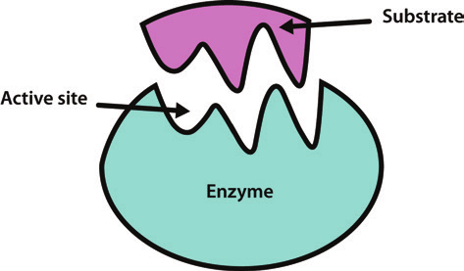
Enzymes
Lesson Objectives:
To define what an enzyme and catalyst are
To explain why enzymes are specific and are denatured by high temperatures and extremes of pH.
Use the model of the lock and key mechanism to explain the function of enzymes
Starter:
What is common about these enzymes?
Protease Lipase Carbohydrase Catalase
Review:

Slide 2

Achieving Objective:
1. To define what an enzyme and catalyst are
Enzymes and Catalysts
Chemical reactions occur naturally, however, some reactions need to be completed quicker than others. Processes such as digestion need to break down larger food particles into smaller ones, which can be absorbed through the intestines. This is done by enzymes in digestive juices. The enzymes are made up of protein molecules and are used as biological catalysts because they speed up the rate of reaction.
Review: What are enzymes?
What are catalysts?

Slide 3
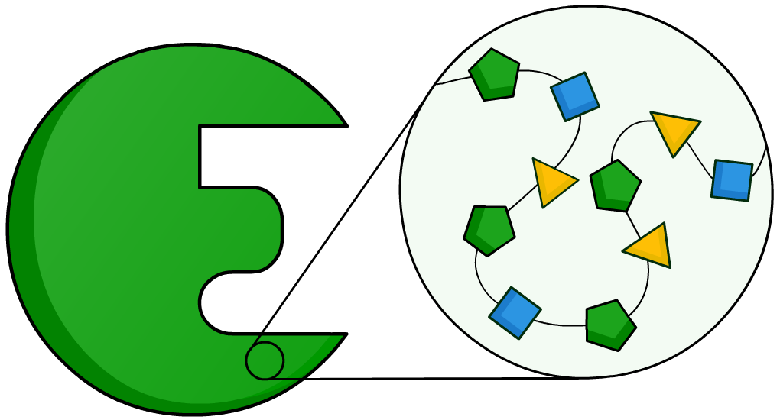
What are enzymes made of?
Enzymes are protein molecules, and so are made up of amino acids. Most enzymes contain between 100 and 1,000 amino acids.
These amino acids are joined together in a long chain, which is folded to produce a unique 3D structure.
http://inteleducationresources.intel.co.uk/content/keystage4/biology/pc/modules/digestion/digestion_part_3/index.html

Slide 4
Achieving Objective:
1. To define what an enzyme and catalyst are
To Do:
Use the information below and from the previous slide to write a definition of an enzyme and a catalyst – write in your own words!
Chemical reactions occur naturally, however, some reactions need to be completed quicker than others. Processes such as digestion need to break down larger food particles into smaller ones, which can be absorbed through the intestines. This is done by enzymes in digestive juices. The enzymes are made up of protein molecules and are used as biological catalysts because they speed up the rate of reaction.
Review: What are enzymes?
What are catalysts?

Slide 5
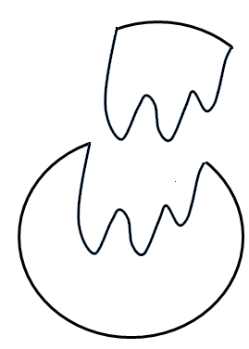
Achieving Objective:
2. Explain why enzymes are specific and are denatured by high temperatures and extremes of pH.
The shape of an enzyme is very important because it has a direct effect on how it catalyses a reaction.
Substrate
Why do enzymes have different shapes?
An enzyme’s shape is determined by the sequence of amino acids in its structure, and the bonds which form between the atoms of those molecules.
Different types of enzymes have different shapes and functions because the order and type of amino acids in their structure is different.
Enzyme

Slide 6
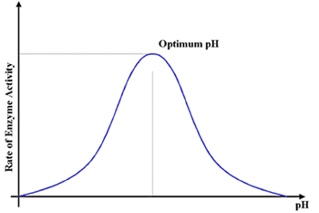
Achieving Objective:
2. Explain why enzymes are specific and are denatured by high temperatures and extremes of pH.
The pH of a solution tells you how acidic or alkaline it is.
Enzymes have an optimum pH – one they like to work at.
If the pH is too high then it will denature the enzyme, this means it changes shape and the substrate can’t then fit into the site.

Slide 7
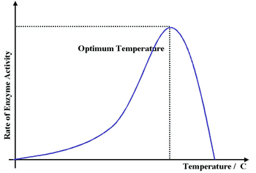
Achieving Objective:
2. Explain why enzymes are specific and are denatured by high temperatures and extremes of pH.
Enzymes like to work at a specific temperature.
When the temperature is too low they do not have enough energy to work.
When the temperature is too high the enzyme becomes denatured. This means that the shape changes so that the substrate can no longer fit into the site.

Slide 8
Achieving Objective:
2. Explain why enzymes are specific and are denatured by high temperatures and extremes of pH.
To Do:
What does the pH of a solution tell you?
Define the term denatured.
Describe what happens to an enzyme when the pH is too high.
Describe what happens to an enzyme when the temperature is too low.
Describe what happens to an enzyme when the temperature is too high.
Stretch – Why do different types of enzymes have different shapes?
Review: Self – assess your answers

Slide 9



Achieving Objective:
3. Use the model of the lock and key mechanism to explain the function of enzymes
To Do:
Substrate
Products
Enzyme-substrate complex
Enzyme
Enzyme
Review:

Slide 10
Achieving Objective:
3. Use the model of the lock and key mechanism to explain the function of enzymes
Substrate
Enzymes are known as Biological catalysts. The enzyme has an active site which the substrate molecule is able to fit into. The substrate molecule is said to have a complementory shape. Enzymes are specific to just one substrate for this reason.
Active Site
Enzyme
Review:

Slide 11
Achieving Objective:
3. Use the model of the lock and key mechanism to explain the function of enzymes
When the substrate and enzyme molecules temporarily combine, it is known as an enzyme-substrate complex. As the enzyme holds onto the substrate molecule, in a certain way, it puts tension onto the substrate molecule. This lowers the activation energy needed for the reaction to take place. This is why reactions can occur at a faster rate.
Substrate-enzyme complex
Review:

Slide 12
Achieving Objective:
3. Use the model of the lock and key mechanism to explain the function of enzymes
During the reaction, the substrate is turned into products. This is released from the enzyme’s active site and the enzyme molecule is left unchanged and free to catalyse again. Each reaction in our body involves a specific enzyme. We have thousands of different enzymes in our body.
Products
Active Site
Enzyme
Review:

Slide 13
Achieving Objective:
3. Use the model of the lock and key mechanism to explain the function of enzymes
To Do:
Explain what is happening in the three stages using the lock and key model and pictures provided.
Products
Substrate
Enzyme-substrate complex
3
1
2
Active Site
Active Site
Enzyme
Enzyme
Review:

Slide 14

Plenary:
Describe how temperature has effected the function of the enzyme
Remember the key words
Deactivate Substrate
Denature Optimum
Active site Activity
Enzyme
Temperature (ᵒC) | 0 | 10 | 20 | 30 | 40 | 50 | 60 | 70
Volume of oxygen (cm³) | 2 | 4 | 9 | 17 | 32 | 15 | 1 | 0

Slide 15
Plenary:
The optimum temperature for this enzyme is 40^{ᵒ}C.
Below 40^{ᵒ}C the enzyme activity is slow e.g. 0^{ᵒ}C only 2cm³ collected.
This rises gradually to the optimum
After 40^{ᵒ}C the enzymes activity decreases a little until at 60^{ᵒ}C and 70^{ᵒ}C only 1cm³ and 0cm³ were collected.
At temperatures above the optimum the active site changes shape as the enzyme is denatured.
The substrate no longer fits so the reaction stops.
Self assess

